Slide 1
Platform Stabilization using PID Controller
Ashwin S - CB.EN.U4ECE23106
Kaushal Soundararajan - CB.EN.U4ECE23125
Nidhil Remila Shivakumaran - CB.EN.U4ECE23129

Slide 2
Objectives
1
To design and implement a platform stabilization system using a PID controller to maintain the platform’s desired orientation despite external disturbances.
2
To design a pendulum based mechanical sensor with connection to a potentiometer to provide real time tilt measurements of the platform. This sensor will generate a signal proportional to the platform’s deviation from desired orientation, which will be used as the input to the PID controller.

Slide 3
Objectives
3
To develop an efficient PID controller with suitable proportional gain (Kp), Integral Gain (Ki) and Differential Gain (Kd) to achieve accurate platform stabilization.
4
To design a motor configuration to control the orientation of the platform on 2 axis based on the output of the PID controller.
5
To implement the PID controller circuit in combination with the mechanical pendulum sensor and motor configuration to perform platform stabilization.

Slide 4
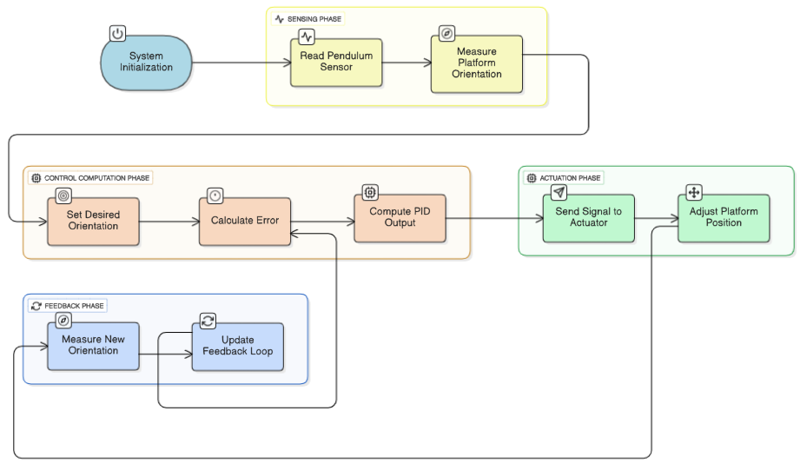
Block Diagram

Slide 5
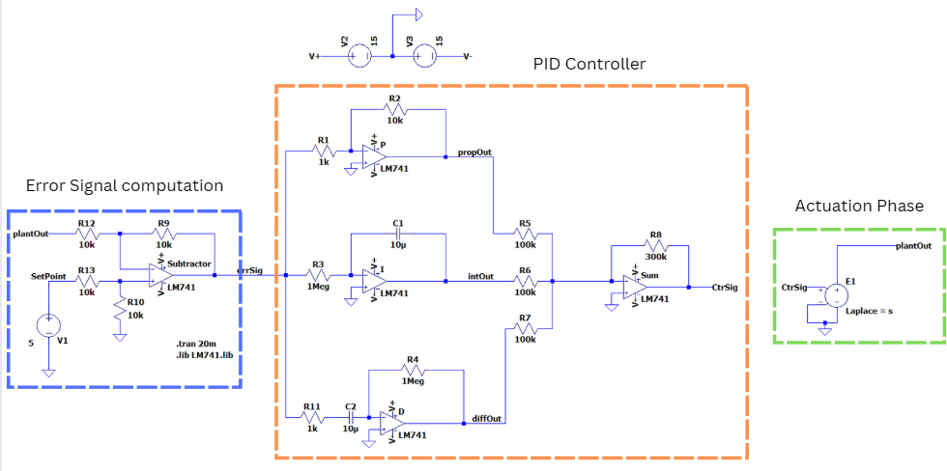
Circuit Diagram

Slide 6



Design
PID CONTROLLER CIRCUIT
2. Transfer Function
  Main Blocks of PID controller
  Proportional Path:
  Integral Path:
  Differential Path:
  Summing Junction:
A summer opamp is used to combine the P, I and D outputs.
  The function C(S) represents the transfer function of the PID circuit in the Laplacian domain.
  The values of Kp, Kd and Ki are the proportional, differential and integral gains.
  These values can be varied to tune the PID controller to give optimal results.
  Kp gives the response to current error.
  Kd gives the response to rate of change of error.
  Ki gives the response to accumulated error.

Slide 7


Design
ACTUATION PHASE CIRCUIT
2. Closed loop Transfer Function
  Transfer Function
  This transfer function defines the whole system and how is responds to signals.
  The closed loop characteristic equation is obtained by equating 1+C(S)G(S) = 0.
  The transfer function G(S) represents the general transfer function of a DC motor with armature.
  Theta(S) is the position of the platform.
  Va(S) is the armature voltage of the DC motor.
  J = Rotor intertia
  B = Viscous friction coefficient
  La = Armature inductance
  Ra = Armature resistance
  Kt = Torque constant
  Kb = Back EMF constant
  By neglecting La as it is a very small value
  With La the closed loop system has an order of 4. This introduces an extra electrical pole with very low time constant. This pole is dominated by mechanical poles with higher time constant

Slide 8








Design
CIRCUIT CALCULATIONS
  Designing PID gains
  Let:
  Substituting the values of coefficients
  where a3, a2, a1 and a0 are the coefficents of the characteristic polynomial.
  The coefficient matching method can be used to find a3, a2, a1, and a0

Slide 9
Design
COMPONENTS REQUIRED
1. Capacitor
2. Resistor
3. TL064
4. Brushed DC Motor with Gear
5. Bread Board
6. Connecting Wires As required
7. DC Power Supply
8. Batteries
9. Potentiometer Bourns PTD904
10. Multimeter
11. DSO

Slide 10
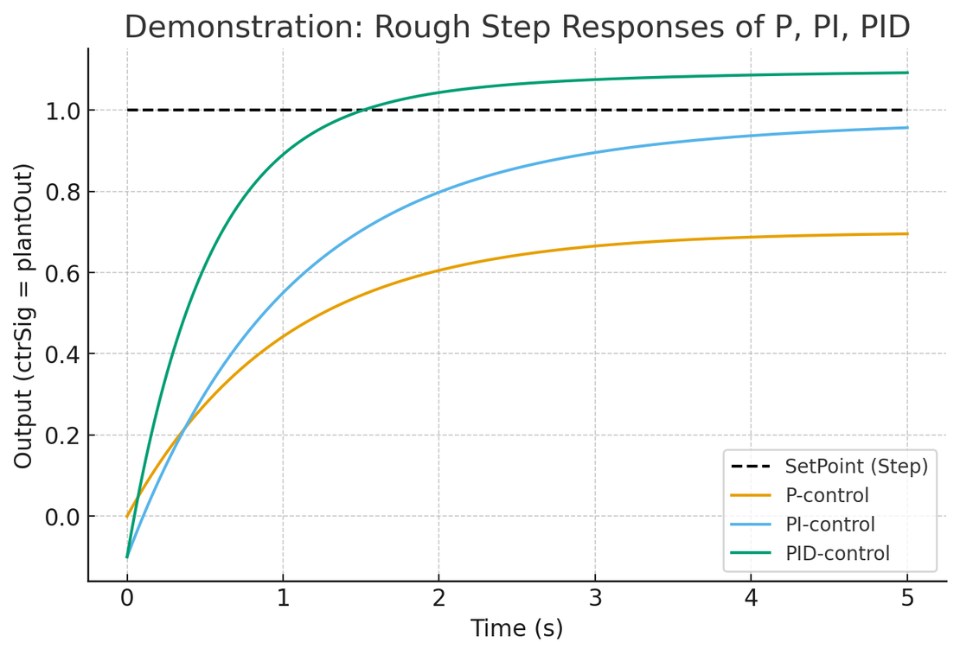
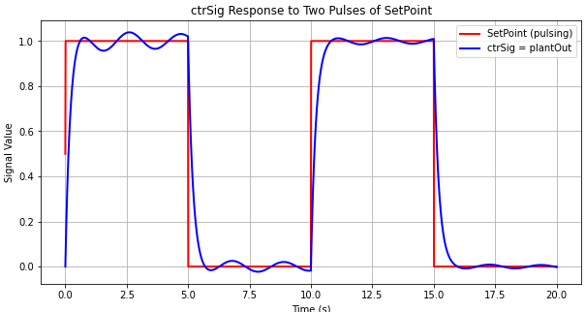
Analysis: Expected Outcome
Unity Plant With PID

Slide 11
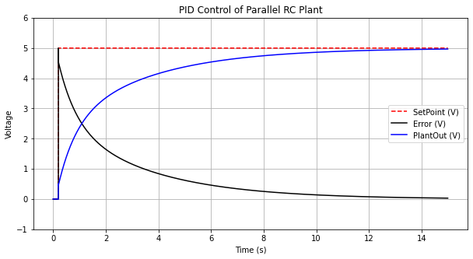
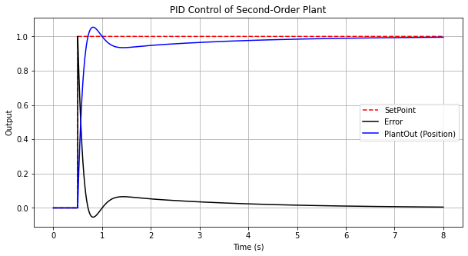
First Order Plant
Second Order Plant

Slide 12
References
  E. E. Theophilus, "Design of Analog PID Controller," Zenodo, 2018. [Online]. Available: https://zenodo.org/record/1467460 DOI: 10.5281/zenodo.1467460
  N. V. Phuong, N. T. Tuyen, N. D. Khanh and N. N. Hung, "Designing a Robust Control System Based on Sliding Mode Control for Two-axis Gimbal Systems," 2024 Conference of Young Researchers in Electrical and Electronic Engineering (ElCon), Saint Petersburg, Russian Federation, 2024, pp. 455-458, doi: 10.1109/ElCon61730.2024.10468229. keywords: {Robust control;Vibrations;Simulation;Stability analysis;Mathematical models;Task analysis;Sliding mode control;two-axis gimbal;inertially stabilized platform;sliding mode control;self-driving transmission;adaptive},
  N. Murata, H. Matsuno, A. Moran, and M. Hayase, “Control of inverted pendulum-wheeled cart systems using nonlinear observers,” SICE ’95. Proceedings of the 34th SICE Annual Conference. International Session Papers, pp. 1133–1136, 2025, doi: https://doi.org/10.1109/sice.1995.526643.
  A. Godfrey, T. Hourigan, and G. M. Olaighin, “Pendulum analysis of an integrated accelerometer to assess its suitability to measure dynamic acceleration for gait applications,” Annual International Conference of the IEEE Engineering in Medicine and Biology Society. IEEE Engineering in Medicine and Biology Society. Annual International Conference, vol. 2007, pp. 4891–4, 2007, doi: https://doi.org/10.1109/IEMBS.2007.4353436.
  A. Suresh and Raju, “A Novel Method to Estimate Tilt Angle of a Body using a Pendulum,” arXiv.org, 2022. https://arxiv.org/abs/2202.00388 (accessed Jul. 28, 2025).
  John, Dina & Sehgal, Saket & Biswas, Karabi. (2020). Hardware Implementation and Performance Study of Analog PID Controllers on DC Motor. Fractal and Fractional. 4. 34. 10.3390/fractalfract4030034.

Slide 13
The End

